Slide 1
Department of Computer Science
DBMS Project Presentation-1
MCA381 Project-1
Project Presentation-1
Submitted by :-
Aritra Sarkar 2247212
Debanjana Mukherjee 2247245
Dinesh R. 2247258
3 MCA B
Guide Name: Lokanayaki K.

Slide 2
01
02
03
AGENDA
Introduction
Overview
SRS Document
04
DFD and Use Case

Slide 3

Introduction

Slide 4
Overview
Hire quest is a platform designed to connect job seekers and employers. It serves as an online job board where companies can post job openings, and job seekers can search for and apply to them.
Searchable Database
Streamline the Hiring Process
Efficient Job and Skill Mapping
Online Job Board

Slide 5
Overview
Features:
Resume-building tools
Salary comparisons
Career advice articles
Enable smart search.
Enable smart suggestions.
Calendar syncing.
Location-based search and results.
Users can Follow the Company.
To use one platform for tests, interview meetings, calls and messages.

Slide 6



Overview
Similar existing systems: Shine.com, Naukri.com
Indeed.com

Slide 7
Disadvantages of Existing systems:
1. Inconsistent Interface.
2. Untrustable sources. (Data leakage, imposter companies, e.t.c)
3. Not suitable for freshers

Slide 8
Proposed System Advantages:
1. Consistent Interface
2. No middle-source Direct Contact between Companies and Users.
3. Targeted for Freshers.
4. More like social media.

Slide 9
SRS DOCUMENT LINK
https://docs.google.com/spreadsheets/d/1axFEj4qigS1xCJeye5qdYsXREvS9xC65RGBGCYcunlU/edit#gid=813405005

Slide 10
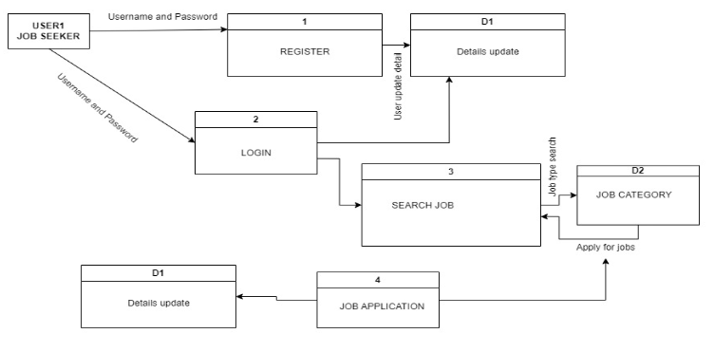
Diagrams
DFD LEVEL 0

Slide 11
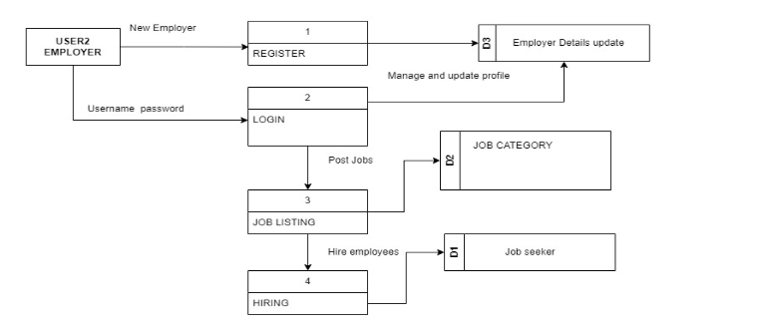
Diagrams
DFD LEVEL 0 contd.

Slide 12
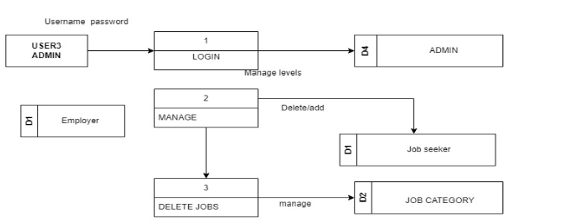
Diagrams
DFD LEVEL 0 contd.

Slide 13
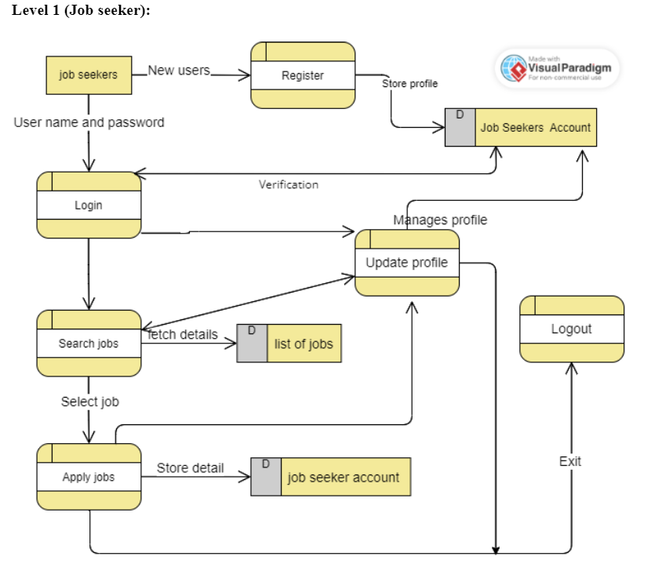
Diagrams
DFD LEVEL 1

Slide 14
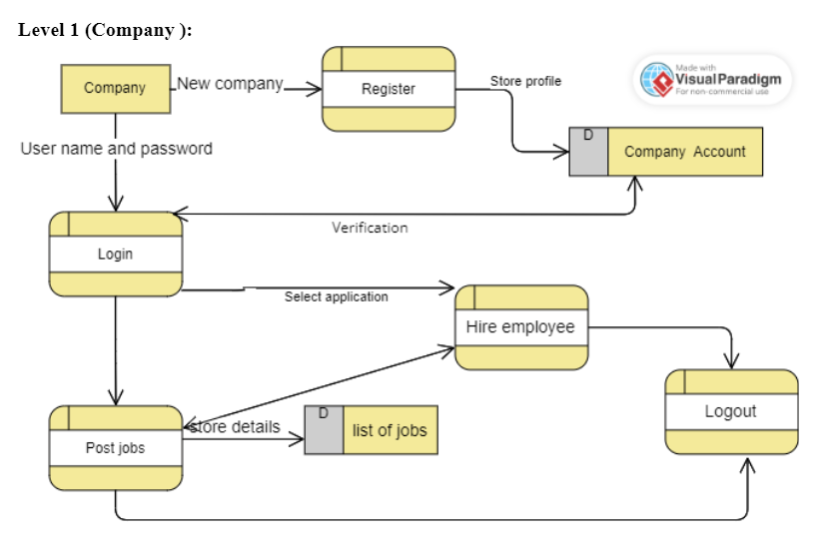
Diagrams
DFD LEVEL 1

Slide 15
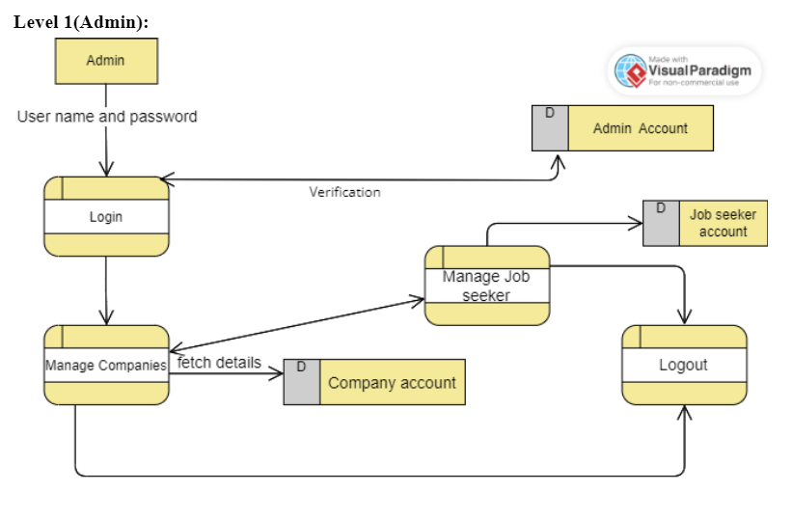
Diagrams
DFD LEVEL 1

Slide 16
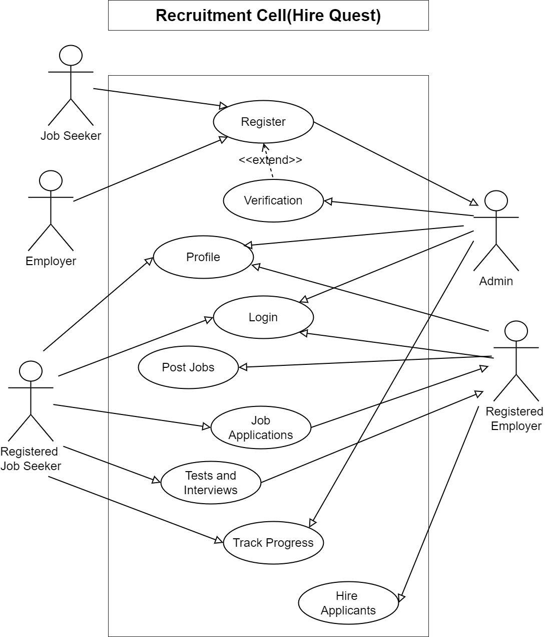
Diagrams
USE CASE DIAGRAM

Slide 17


